Slide 1
Chapter 7: Characters, Strings, and the StringBuilder

Slide 2
Objectives
Identify string data problems
Manipulate characters
Declare and compare String objects
Use other String methods
Convert String objects to numbers
Use the StringBuilder and StringBuffer classes
Java Programming, Seventh Edition

Slide 3
Understanding String Data Problems
Manipulating characters and groups of characters provides some challenges for the beginning Java programmer
A String is a class
  Each created String is a class object
  The String variable name is not a simple data type
  Reference
    A variable that holds a memory address
Java Programming, Seventh Edition

Slide 4
Understanding String Data Problems (cont’d.)
Compare two Strings using the == operator
  Not comparing values
  Comparing computer memory locations
Compare contents of memory locations more frequently than memory locations themselves
Java Programming, Seventh Edition

Slide 5
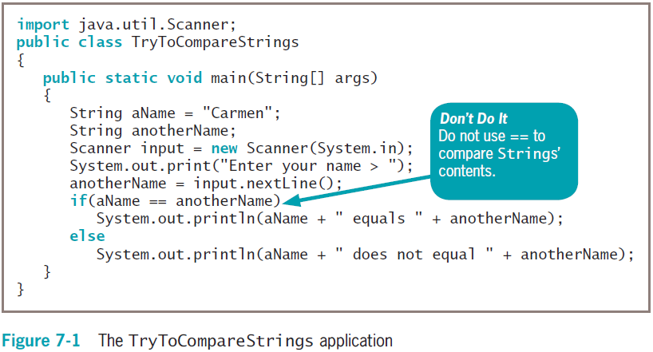
Understanding String Data Problems (cont’d.)
Java Programming, Seventh Edition

Slide 6
Understanding String Data Problems (cont’d.)
Classes to use when working with character data
  Character
    Instances hold a single character value
    Defines methods that can manipulate or inspect single-character data
  String
    A class for working with fixed-string data
      Unchanging data composed of multiple characters
Java Programming, Seventh Edition

Slide 7
Understanding String Data Problems (cont’d.)
Classes to use when working with character data (cont’d.)
  StringBuilder and StringBuffer
    Classes for storing and manipulating changeable data composed of multiple characters
Java Programming, Seventh Edition

Slide 8
Manipulating Characters
Character class
  Contains standard methods for testing the values of characters
  Methods that begin with “is”
    Such as isUpperCase()
    Return a Boolean value that can be used in comparison statements
  Methods that begin with “to”
    Such as toUpperCase()
    Return a character that has been converted to the stated format
Java Programming, Seventh Edition

Slide 9
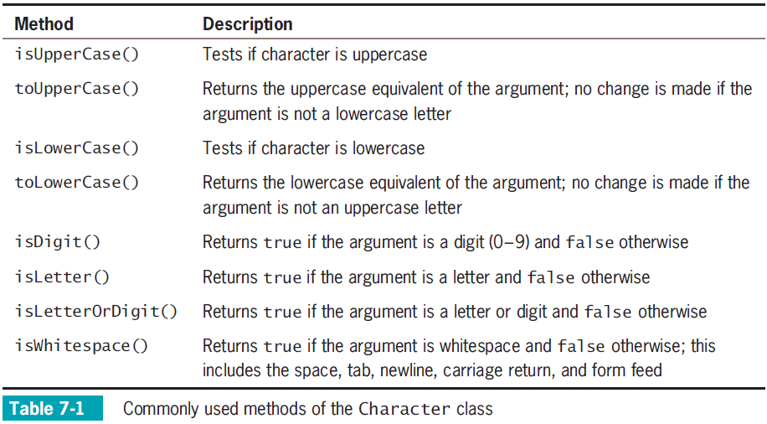
Manipulating Characters (cont’d.)
Java Programming, Seventh Edition

Slide 10
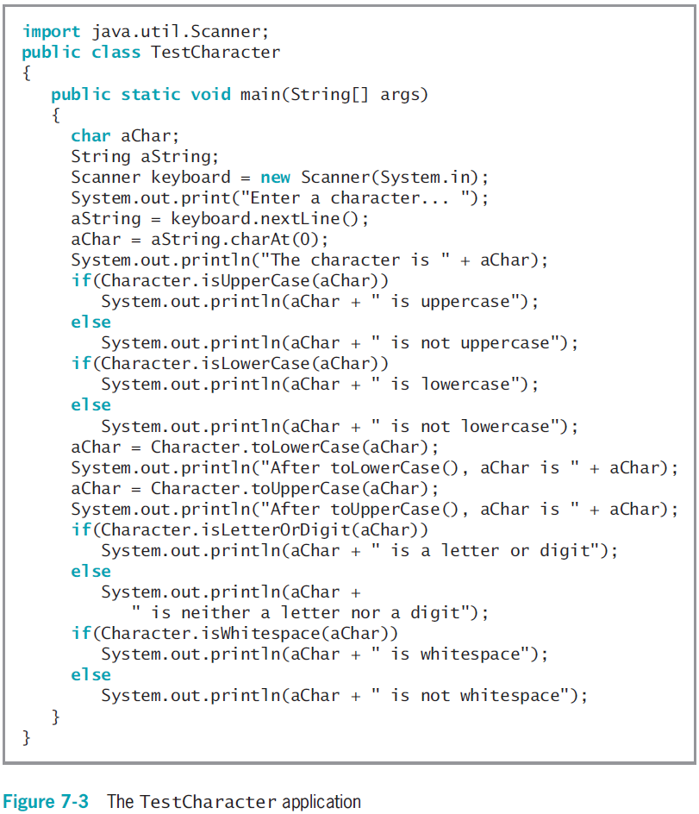
Manipulating Characters (cont’d.)
Java Programming, Seventh Edition

Slide 11
Declaring and Comparing String Objects
Literal string
  A sequence of characters enclosed within double quotation marks
  An unnamed object, or anonymous object, of the String class
String variable
  A named object of the String class
Class String
  Defined in java.lang.String
  Automatically imported into every program
Java Programming, Seventh Edition

Slide 12
Declaring and Comparing String Objects (cont’d.)
Declare a String variable
  The String itself is distinct from the variable used to refer to it
Create a String object
  String aGreeting = new String("Hello");
  String aGreeting = "Hello";
  You can create a String object without:
    Using the keyword new
    Explicitly calling the class constructor
Java Programming, Seventh Edition

Slide 13
Comparing String Values
String is a class
  Each created String is a class object
String variable name
  A reference variable
  Refers to a location in memory
    Rather than to a particular value
Assign a new value to a String
  The address held by the String is altered
Java Programming, Seventh Edition

Slide 14
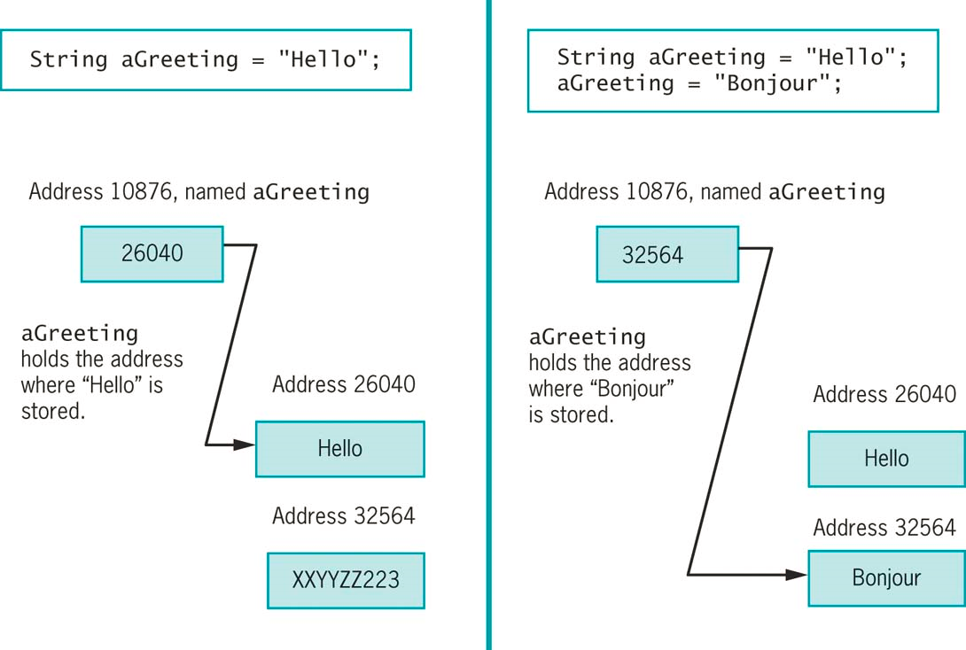
Comparing String Values (cont’d.)
Figure 7-6 Contents of aGreeting at declaration and after an assignment
Java Programming, Seventh Edition

Slide 15
Comparing String Values (cont’d.)
Immutable
  Objects that cannot be changed, such as a String
Making simple comparisons between Strings often produces misleading results
Compare Strings using the == operator
  Compare memory addresses, not values
Java Programming, Seventh Edition

Slide 16
Comparing String Values (cont’d.)
equals() method
  Evaluates the contents of two String objects to determine if they are equivalent
  Returns true if objects have identical contents
  public boolean equals(String s)
equalsIgnoreCase() method
  Ignores case when determining if two Strings are equivalent
  Useful when users type responses to prompts in programs
Java Programming, Seventh Edition

Slide 17
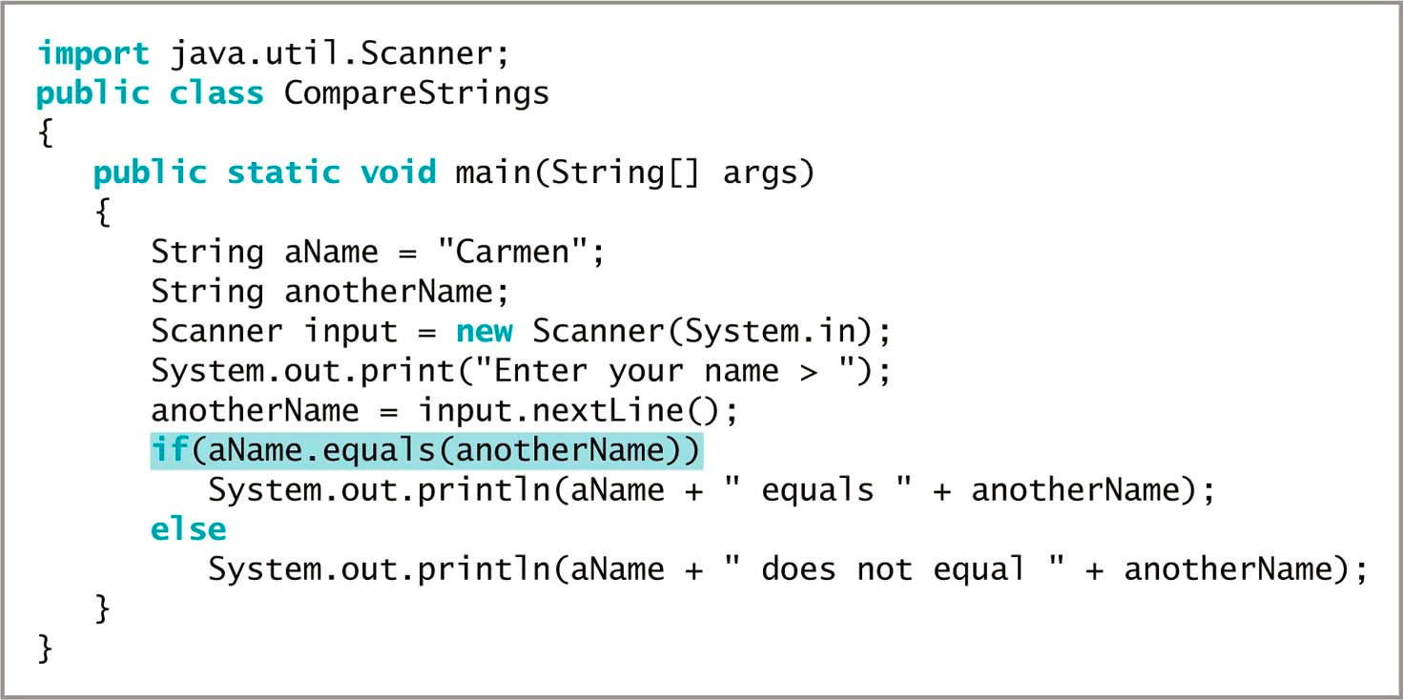
Comparing String Values (cont’d.)
Figure 7-7 The CompareStrings application
Java Programming, Seventh Edition

Slide 18
Comparing String Values (cont’d.)
compareTo() method
  Compares two Strings and returns:
    Zero
      Only if two Strings refer to the same value
    Negative number
      If the calling object is “less than” the argument
    Positive number
      If the calling object is “more than” the argument
  if (aWord.compareTo(anotherWord) < 0)
Java Programming, Seventh Edition

Slide 19
Empty and null Strings
Empty Strings
Reference a memory address with no characters
  Can be used in String methods
null Strings
  Use the null Java keyword
  Strings are set to null by default
  Cannot be used in String methods
Java Programming, Seventh Edition

Slide 20
Using Other String Methods
toUpperCase() and toLowerCase() methods
  Convert any String to its uppercase or lowercase equivalent
length() method
  Returns the length of a String
Java Programming, Seventh Edition

Slide 21
Using Other String Methods (cont’d.)
indexOf() method
  Determines whether a specific character occurs within a String
  Returns the position of the character
  The first position of a String is zero
  The return value is –1 if the character does not exist in the String
Java Programming, Seventh Edition

Slide 22
Using Other String Methods (cont’d.)
charAt() method
  Requires an integer argument
  Indicates the position of the character that the method returns
endsWith() method and startsWith() method
  Each take a String argument
  Return true or false if a String object does or does not end or start with the specified argument, respectively
Java Programming, Seventh Edition

Slide 23
Using Other String Methods (cont’d.)
replace() method
  Replaces all occurrences of some character within a String
toString() method
  Not part of the String class
  Converts any object to a String
  Converts primitive data types to Strings
  String theString;
  int someInt = 4;
  theString = Integer.toString(someInt);
Java Programming, Seventh Edition

Slide 24
Using Other String Methods (cont’d.)
Concatenation
  Join a simple variable to a String
  String aString = "My age is " + myAge;
  Use the + operator
Java Programming, Seventh Edition

Slide 25
Using Other String Methods (cont’d.)
substring() method
  Extracts part of a String
  Takes two integer arguments
    Start position
    End position
  The length of the extracted substring is the difference between the second integer and the first integer
Java Programming, Seventh Edition

Slide 26
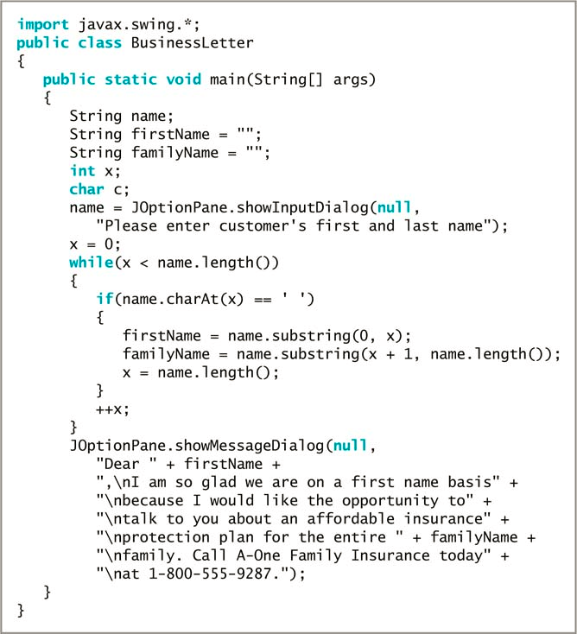
Figure 7-9 The BusinessLetter application
Java Programming, Seventh Edition

Slide 27
Using Other String Methods (cont’d.)
regionMatches() method
  Two variants that can be used to test if two String regions are equal
A substring of the specified String object is compared to a substring of the other
  If the substrings contain the same character sequence, then the expression is true
  Otherwise, the expression is false
A second version uses an additional boolean argument
  Determines whether case is ignored when comparing characters
Java Programming, Seventh Edition

Slide 28
Converting String Objects to Numbers
Integer class
  Part of java.lang
  Automatically imported into programs
  Converts a String to an integer
  parseInt() method
    Takes a String argument
    Returns its integer value
Wrapper
  A class or an object “wrapped around” a simpler element
Java Programming, Seventh Edition

Slide 29
Converting String Objects to Numbers (cont’d.)
Integer class valueOf() method
  Converts a String to an Integer class object
Integer class intValue() method
  Extracts the simple integer from its wrapper class
Double class
  A wrapper class
  Imported into programs automatically
  parseDouble() method
    Takes a String argument and returns its double value
Java Programming, Seventh Edition

Slide 30
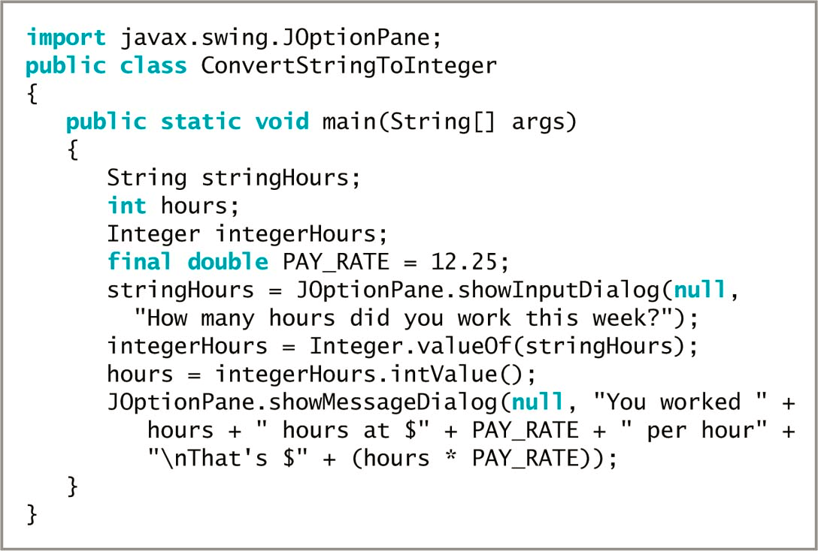
Converting String Objects to Numbers (cont’d.)
Figure 7-12 The ConvertStringToInteger application
Java Programming, Seventh Edition

Slide 31
Learning About the StringBuilder and StringBuffer Classes
The value of a String is fixed
  After a String is created, it is immutable
StringBuilder and StringBuffer classes
  An alternative to the String class
  Used when a String will be modified
  Can use anywhere you would use a String
  Part of the java.lang package
  Automatically imported into every program
Java Programming, Seventh Edition

Slide 32
Learning About the StringBuilder and StringBuffer Classes (cont’d.)
StringBuilder
  More efficient
StringBuffer
  Thread safe
  Use in multithreaded programs
Java Programming, Seventh Edition

Slide 33
Learning About the StringBuilder and StringBuffer Classes (cont’d.)
Create a StringBuilder object
  StringBuilder eventString = new StringBuilder ("Hello there");
  Must use:
    The keyword new
    The constructor name
    An initializing value between the constructor’s parentheses
Java Programming, Seventh Edition

Slide 34
Learning About the StringBuilder and StringBuffer Classes (cont’d.)
Buffer
  A memory block
  Might or might not contain a String
  The String might not occupy the entire buffer
    The length of a String can be different from the length of the buffer
  Capacity
    The actual length of the buffer
Java Programming, Seventh Edition

Slide 35
Learning About the StringBuilder and StringBuffer Classes (cont’d.)
setLength() method
  Changes the length of a String in a StringBuilder object
length property
  An attribute of the StringBuilder class
  Identifies the number of characters in the String contained in the StringBuilder
capacity() method
  Finds the capacity of a StringBuilder object
Java Programming, Seventh Edition

Slide 36
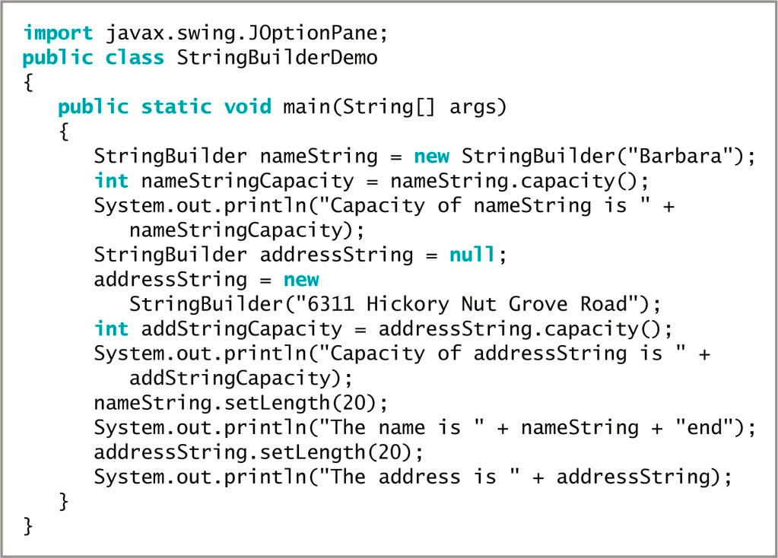
Figure 7-15 The StringBuilderDemo application
Java Programming, Seventh Edition

Slide 37
Learning About the StringBuilder and StringBuffer Classes (cont’d.)
Using StringBuilder objects
  Provides improved computer performance over String objects
  Can insert or append new contents into StringBuilder
StringBuilder constructors
  public StringBuilder ()
  public StringBuilder (int capacity)
  public StringBuilder (String s)
Java Programming, Seventh Edition

Slide 38
Learning About the StringBuilder and StringBuffer Classes (cont’d.)
append() method
  Adds characters to the end of a StringBuilder object
insert() method
  Adds characters at a specific location within a StringBuilder object
setCharAt() method
  Changes a character at a specified position within a StringBuilder object
Java Programming, Seventh Edition

Slide 39
Learning About the StringBuilder and StringBuffer Classes (cont’d.)
charAt() method
  Accepts an argument that is the offset of the character position from the beginning of a String
  Returns the character at that position
Java Programming, Seventh Edition

Slide 40
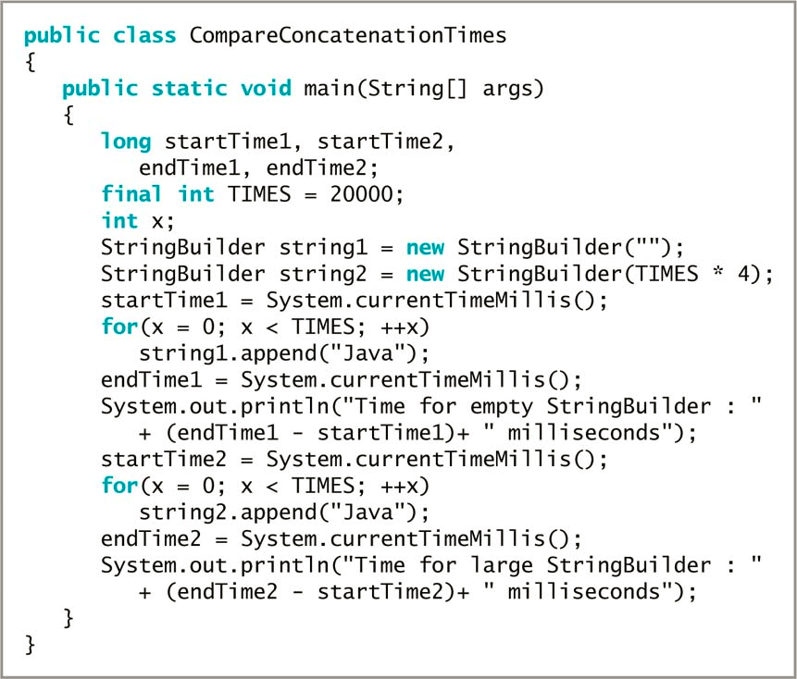
Figure 7-17 The CompareConcatenationTimes application
Java Programming, Seventh Edition

Slide 41
You Do It
Retrieving and Testing a Character
Examining the String Class at the Java Web Site
Using String Class Methods
Converting a String to an Integer
Using StringBuilder Methods
Java Programming, Seventh Edition

Slide 42
Don’t Do It
Don’t attempt to compare Strings using the standard comparison operators
Don’t forget that startsWith(), endsWith(), and replace() are case sensitive
Don’t forget to use the new operator and the constructor when declaring initialized StringBuilder objects
Java Programming, Seventh Edition

Slide 43
Summary
String variables
  References
Character class
  Instances can hold a single character value
Each String class object
  Immutable
  equals() method
toString() method
  Converts any object to a String
Java Programming, Seventh Edition

Slide 44
Summary (cont’d.)
Integer.parseInt() method
  Takes a String argument and returns an integer value
Double.parseDouble() method
  Takes a String argument and returns a double value
StringBuilder or StringBuffer class
  Improves performance when a string’s contents must change
Java Programming, Seventh Edition

